Slide 1
Global Data on Sustainable Energy
By: Team 2

Slide 2
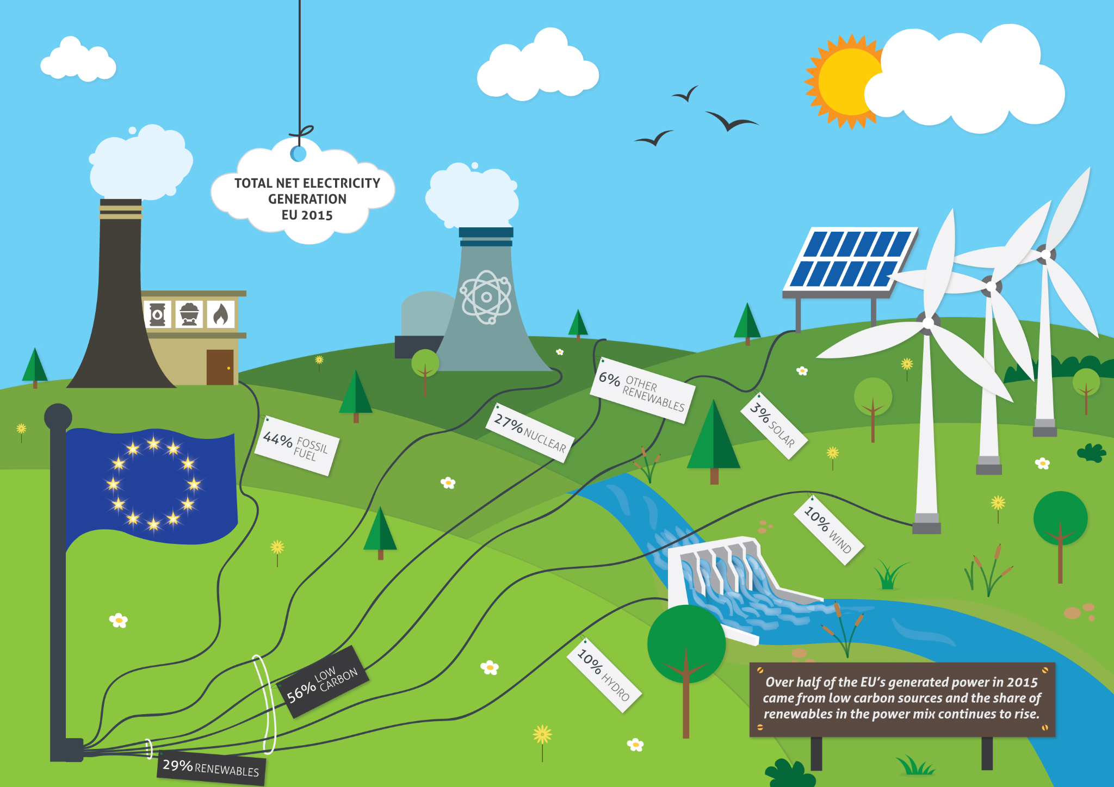
Problem Statement and Motivation
The objective of this analysis is to explore the trends for different countries over the year 2000 to 2020
Access to electricity
Distribution of electricity sources (fossil fuels and renewables)

Slide 3

Data Source
The data was collected from Kaggle (Global Data on Sustainable Energy (2000-2020)
The table had 21 columns and 3650 rows
Appx 200 countries
https://www.kaggle.com/datasets/anshtanwar/global-data-on-sustainable-energy

Slide 4
Solution Workflow
CSV
DATASET
CLEAN UP
SQLITE
HTML
API
FLASK APP

Slide 5
Insights
We noticed that access to energy of African countries were lower compared to North american and european countries
Increasing amount of countries leaning towards renewable energy especially South American countries
North American countries were generally fossil-fuel dependent
Asian countries slowly bringing more renewable sources

Slide 6
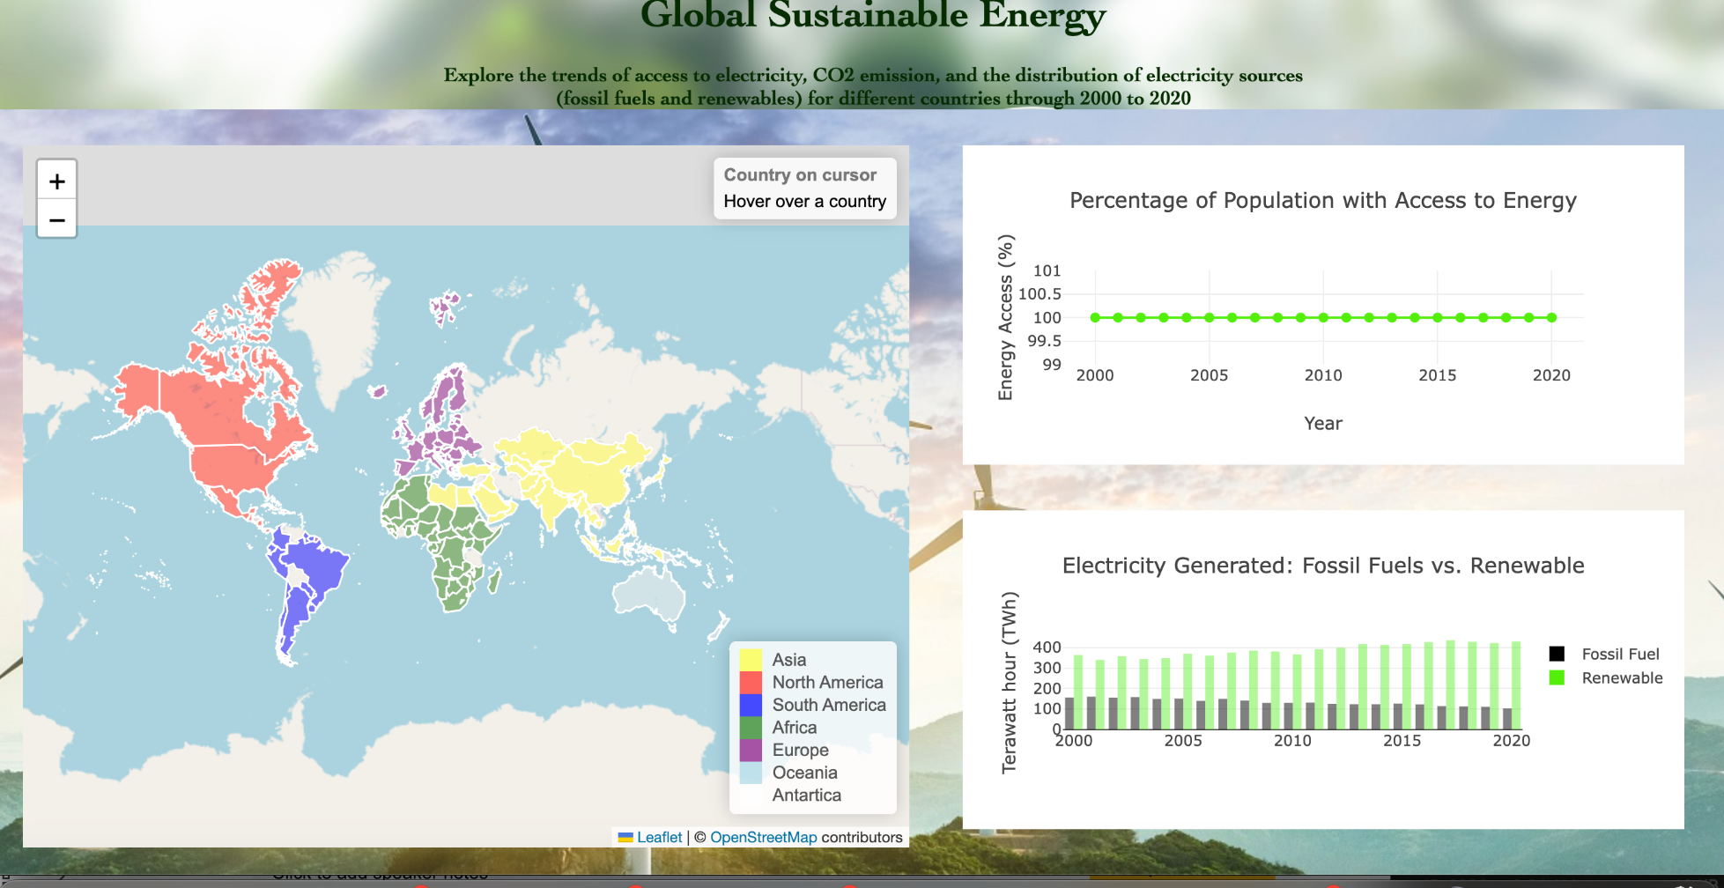
The HTML Snapshot

Slide 7

Limitations and Assumptions?
Some columns had no data so we deleted those columns
For the columns that we used, the NaN entries were filled with zeros so we can still graph them

Slide 8
Future Plan for the project
If there was more time, we wanted to explore comparing data for 2 countries side by side
We would also gather more information for the countries to add to the popup
Add more graphs from other datasets

